Slide 1

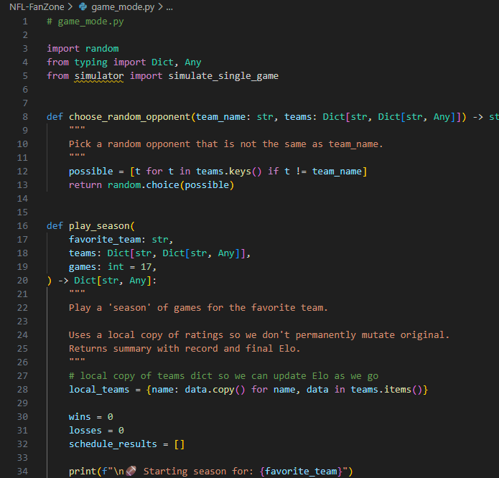
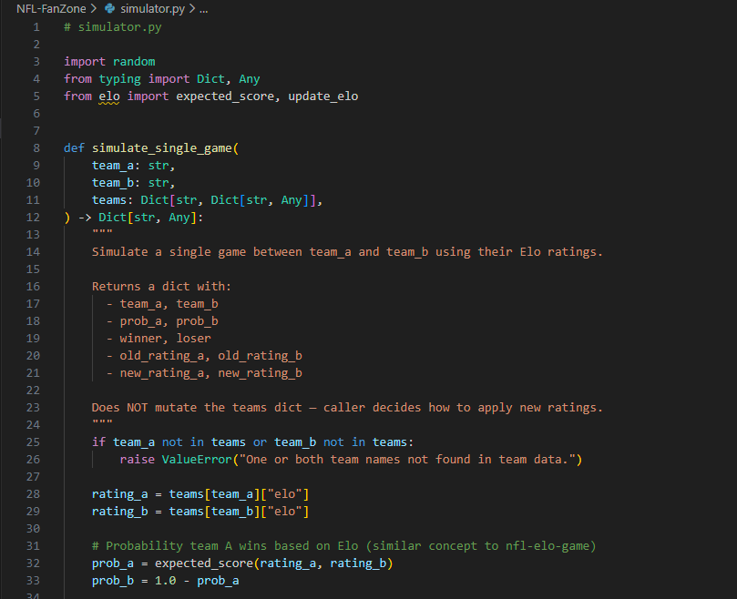
NFL FanZone
Lexington Vue
A Data‑Driven, Game‑Style NFL Simulation Experience
Turns real NFL team metrics into win probabilities so users can simulate games, series, or full seasons

